Slide 1
Data Structures
Stack and Applications

Slide 2
Topics
Stack
Concept
Implementation
Attribute
Methods
C Sharp - Stack
Applications
Expression
In-fix
Post-fix
Pre-fix

Slide 3
Stack - concept
PUSH ( 5 )
PUSH ( 4 )
PUSH ( 7 )
← POP ()
← POP ()
PUSH ( 9 )
← TOP ()
← TOP ()
← TOP ()
← POP ()
….
LIFO (Last In First Out)
Property
top
Methods
PUSH ( )
POP ()
TOP()/PEEK()
Errors
Under Flow
Over Flow

Slide 4
Stack Implementation
Attribute
Top element
Methods
Push
Pop
Top/Peek

Slide 5

Stack

Slide 6
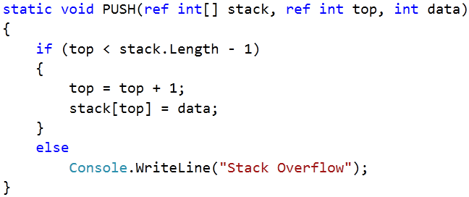
Stack

Slide 7
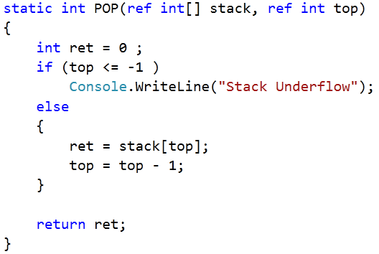
Stack

Slide 8
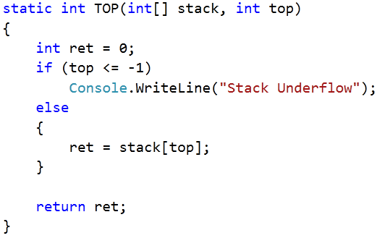
Stack

Slide 9
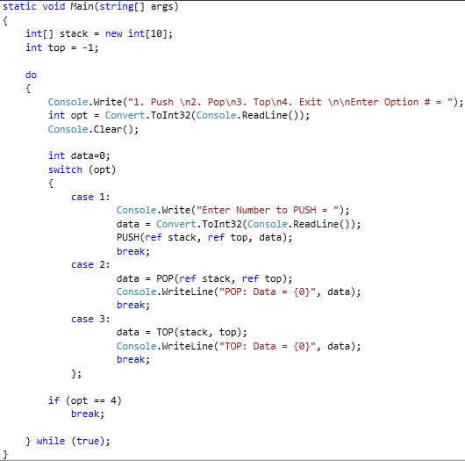

Slide 10
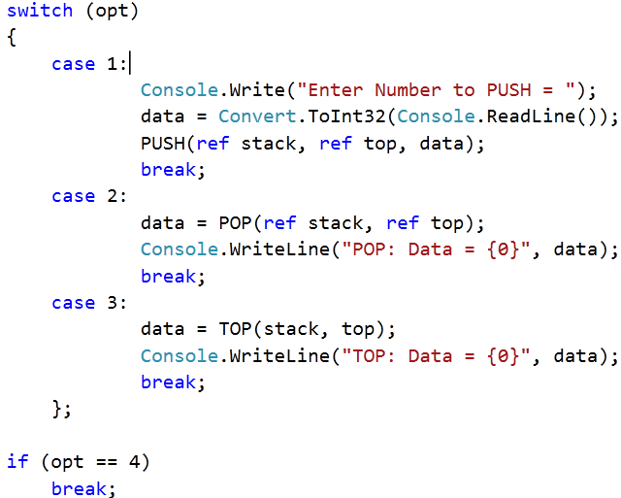

Slide 11
Problem
Generic Stack
Apply Generics to form your own generic stack operations that can process any type of data .

Slide 12
Stack – C Sharp
Include :
using System.Collections;
using System.Collections.Generic;
Declare :
Stack<string> numbers = new Stack<string>();
Access :
numbers.Push("one"); //add new element
string_variable = numbers.Pop(); // remove top element
string_variable = numbers.Peek(); // returns top element

Slide 13
Stack – C Sharp
Property :
public int Count { get; }
Other Methods :
Method | Description
Clear | Removes all objects from the Stack<T>.
Contains | Determines whether an element is in the Stack<T>.

Slide 14
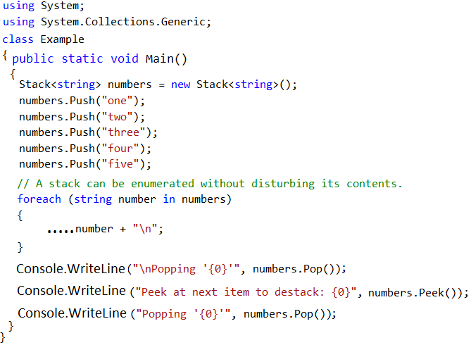
Example - Stack

Slide 15
Expression Parser
Infix | Postfix | Prefix
A + B | A B + | + A B
A + B * C - D | A B C * + D - | - + A * B C D
( A + B ) * ( C – D ) | A B + C D - * | * + A B - C D

Slide 16
Infix → postfix
Infix | Postfix
A + B | A B +

Slide 17
Infix → postfix
Infix | Postfix
A + B * C - D | A B C * + D -

Slide 18
Infix → postfix
Infix | Postfix
( A + B ) * ( C – D ) | A B + C D - *

Slide 19
Expression Evaluation
How programs uses postfix expressions to evaluate results step by step?

Slide 20
Mini Project
Expression Parser
(with single digit numbers and single char variable names)
Part 1:
Input : Infix Expression
Processing : Infix → postfix
Output : Postfix Expression
Part 2:
Input : Postfix Expression
Processing:
Get values for variables used in expression
Evacuate Result
Output : Final Result

